Slide 1


Slide 2
What is Kafka?
❖ Distributed Streaming Platform
❖ Publish and Subscribe to streams of records
❖ Fault tolerant storage
❖ Replicates Topic Log Partitions to multiple servers
❖ Process records as they occur
❖ Fast, efficient IO, batching, compression, and more
❖ Used to decouple data streams

Slide 3
Why Kafka is Needed?
❖ Real time streaming data processed for real time analytics
❖ Service calls, track every call, IOT sensors
❖ Apache Kafka is a fast, scalable, durable, and fault tolerant publish-subscribe messaging system
❖ Kafka is often used instead of JMS, RabbitMQ and AMQP
❖ Higher throughput, reliability and replication

Slide 4
Kafka Use Cases
❖ Stream Processing
❖ Website Activity Tracking
❖ Metrics Collection and Monitoring
❖ Log Aggregation
❖ Real time analytics
❖ Capture and ingest data into Spark / Hadoop
❖ CRQS, replay, error recovery
❖ Guaranteed distributed commit log for in-memory computing

Slide 5
Kafka Architecture
Producer
Producer
Broker
Broker
ZK
Broker
Broker
Consumer
Consumer

Slide 6
What is Publish and Subscribe ?
Producer
Publish(Topic, msg)
Consumer
Subscribe
Topic 1
Topic 2
Msg
Topic 3
Publish subscribe
system
Consumer
Producer
Msg
Notes:
Multiple subscribers, decoupling
Some examples : email notification on adding connection etc

Slide 7
Kafka Fundamentals
❖ Records have a key (optional), value and timestamp; Immutable
❖ Topic a stream of records (“/orders”, “/user-signups”), feed name
❖ Log topic storage on disk
❖ Partition / Segments (parts of Topic Log)
❖ Producer API to produce a streams or records
❖ Consumer API to consume a stream of records
❖ Broker: Kafka server that runs in a Kafka Cluster. Brokers form a cluster. Cluster consists on many Kafka Brokers on many servers.
❖ ZooKeeper: Does coordination of brokers/cluster topology. Consistent file system for configuration information and leadership election for Broker Topic Partition Leaders

Slide 8
Why Kafka needs Zookeeper ?
❖ Zookeeper helps with leadership election of Kafka Broker and Topic Partition pairs
❖ Zookeeper manages service discovery for Kafka Brokers that form the cluster ❖ Zookeeper sends changes to Kafka
❖ New Broker join, Broker died, etc.
❖ Topic removed, Topic added, etc.
❖ Zookeeper provides in-sync view of Kafka Cluster configuration

Slide 9
Kafka Producer/Consumer Details
❖ Producers write to and Consumers read from Topic(s)
❖ Topic associated with a log which is data structure on disk
❖ Producer(s) append Records at end of Topic log
❖ Topic Log consist of Partitions –
❖ Spread to multiple files on multiple nodes
❖ Consumers read from Kafka at their own cadence
❖ Each Consumer (Consumer Group) tracks offset from where they left off reading
❖ Partitions can be distributed on different machines in a cluster
❖ high performance with horizontal scalability and failover with replication

Slide 10
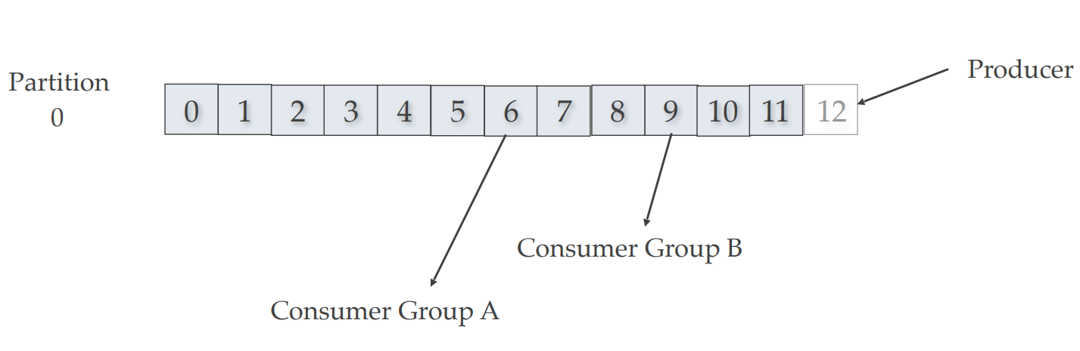
Kafka Topic Partition, Consumers, Producers
Consumer groups remember offset where they left off. Consumers groups each have their own offset.
Producer writing to offset 12 of Partition 0 while… Consumer Group A is reading from offset 6. Consumer Group B is reading from offset 9.

Slide 11
Kafka Scale and Speed
❖ How can Kafka scale if multiple producers and consumers read/write to same Kafka Topic log?
❖ Writes fast: Sequential writes to filesystem are fast (700 MB or more a second)
❖ Scales writes and reads by Sharding:
❖ Topic logs into Partitions (parts of a Topic log)
❖ Topics logs can be split into multiple Partitions different machines/ different disks
❖ Multiple Producers can write to different Partitions of the same Topic
❖ Multiple Consumers Groups can read from different partitions efficiently

Slide 12
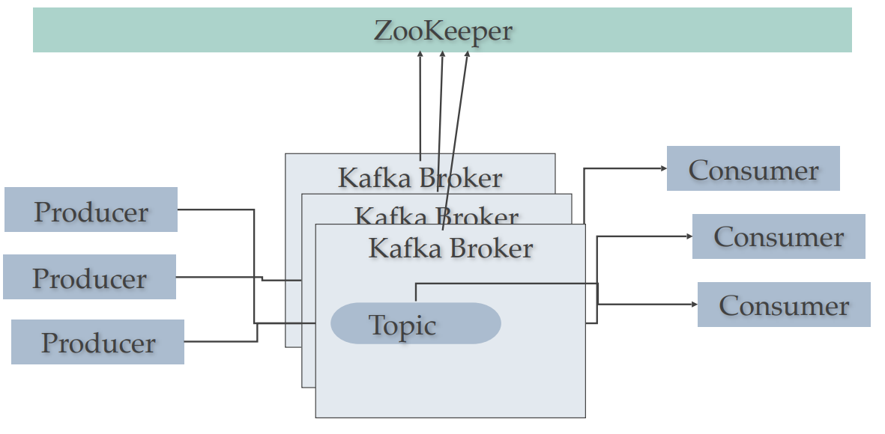
Kafka Cluster, Failover, ISRs
❖ Topic Partitions can be replicated across multiple nodes for failover
❖ Topic should have a replication factor greater than 1 (2, or 3)
❖ Failover : If one Kafka Broker goes down then Kafka Broker with ISR (in-sync replica) can serve data

Slide 13
Things We Can Test in a Kafka Applications
Whether we have produced the record to a particular partition.
The type of record we are able to produce or consume.
The number of records written to a topic or fetched from a topic.
The offset of the record.

Slide 14
Kafka Console API
kafka-console-producer --broker-list ${broker_server}:9092 --topic ${topic_name} --producer.config /${path}/producer-client.properties
kafka-console-consumer --new-consumer --topic ${topic_name} --from-beginning --bootstrap-server ${broker_server}:9092 --consumer.config /${path}/consumer-client.properties

Slide 15
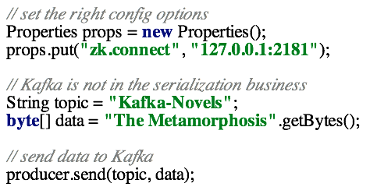

Slide 16
